Slide 1
NovaMed-Solutions

Slide 2
Project Background
NovaMed Solutions, established in 2022, is a prominent pharmaceutical distributor offering prescription medicines online and through pharmacies.
The company serves a diverse healthcare sector but faces challenges in demand forecasting, stock management, and customer engagement, impacting its operations.
With large data silos of sales records, customer information, and drug data, NovaMed struggles to consolidate sales performance, manage inventory, and identify market opportunities.
Analysing comprehensive sales data, including revenue and customer demographics, aims to enhance business strategies and streamline operations through data-driven decisions.

Slide 3

Key Insights
✅ Top/Bottom Analysis: This involves tracking overall sales metrics, including revenue, profit, and cost of goods sold (COGS).
✅ Month-over-Month Comparison: An analysis comparing the performance of drugs in terms of revenue and profit with the previous month.
✅ Customer Analysis: An assessment of how customer segments, such as age group, purchasing category, and gender, influence revenue, profit, and sales.
✅ Geographical Analysis: An examination of the key revenue sources based on customers' geographical locations, including countries.

Slide 4
Data Structure & Initial Checks
NovaMed-Solutions has a database structure consisting of 4 tables:
Sales Fact Table, Customer Dim, Drug Lookup Dim, and Calendar Dim, with the Sales Fact Table containing 16,314 records.
Sales Fact Table: This is the frequently updated table with a primary key (SaleID) and foreign keys (DrugID, CustomerID, Sale Date). It includes columns for Units Sold, Buyer Type, and calculated columns for Revenue, Profit, and Cost of Goods.
Customer Dim: Contains customer data such as First Name, Last Name, Age, and Gender, along with a calculated column for Age Group for better analysis.
Drug Lookup Dim: Holds drug details like RegulatoryComplianceID, Drug Name, Unit Sales Price, Cost of Production, and Treats. Its numerical columns are used to create calculated columns in the Sales Fact Table using the RELATED keyword.
Calendar Dim: Features a custom calendar aligned with NovaMed’s business periods, including Year, Month Name, and Date Month Number for month-over-month analysis.

Slide 5
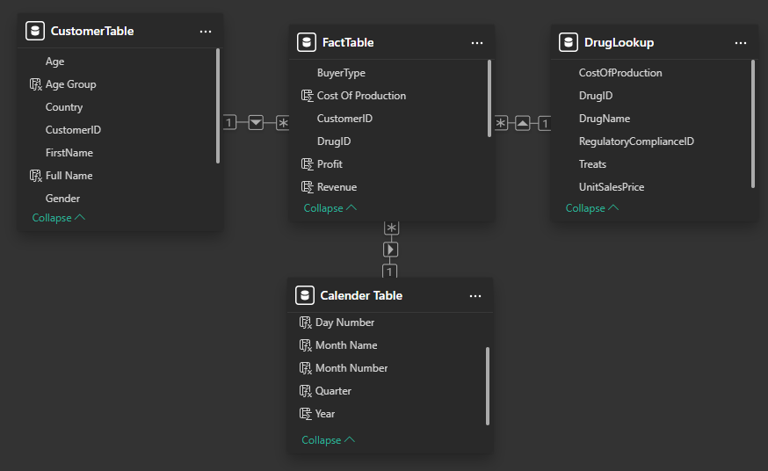
Entity Relationship Diagram

Slide 6

Data Cleaning & Transformation
🗑️ Removing duplicate IDs and replacing errors with placeholder values.
🔧 Converting column types into the correct data type, e.g. MM-DD-YYYY, to short date using Locale.
👥 Grouping customer ages from raw numeric values into age segments.
🔗 Creating relationships by establishing 1-to-many links between the dimension tables and the fact table.
📅 Improving time intelligence by using both the month name and the month number.

Slide 7
Executive Summary
The profit margin has been high, averaging 82.06% from 2022 to the present.
In 2023, revenue peaked at 39.26 million dollars, while revenues for recent years, such as 2025, only reached 914.52 thousand dollars.
Lisnopril comprised 67.96% of sales from 10,000 goods sold, but Doxycycline led in profit and revenue, generating 2.2 million dollars in profit and 2.3 million dollars in revenue.
Lisnopril followed with 2.1 million dollars in revenue and 1.9 million dollars in profit.
Underperforming drugs, like amoxicillin and fluticasone, made between 18.77 thousand and 82.59 thousand dollars.

Slide 8
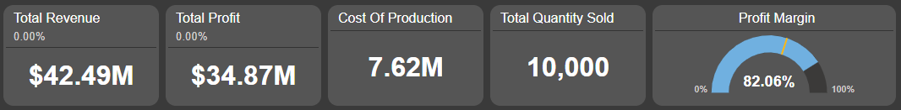
Executive Summary
The profit margin has been high, averaging 82.06% from 2022 to the present.
In 2023, revenue peaked at 39.26 million dollars, while revenues for recent years, such as 2025, only reached 914.52 thousand dollars.
Lisnopril comprised 67.96% of sales from 10,000 goods sold, but Doxycycline led in profit and revenue, generating 2.2 million dollars in profit and 2.3 million dollars in revenue.
Lisnopril followed with 2.1 million dollars in revenue and 1.9 million dollars in profit.
Underperforming drugs, like amoxicillin and fluticasone, made between 18.77 thousand and 82.59 thousand dollars.

Slide 9
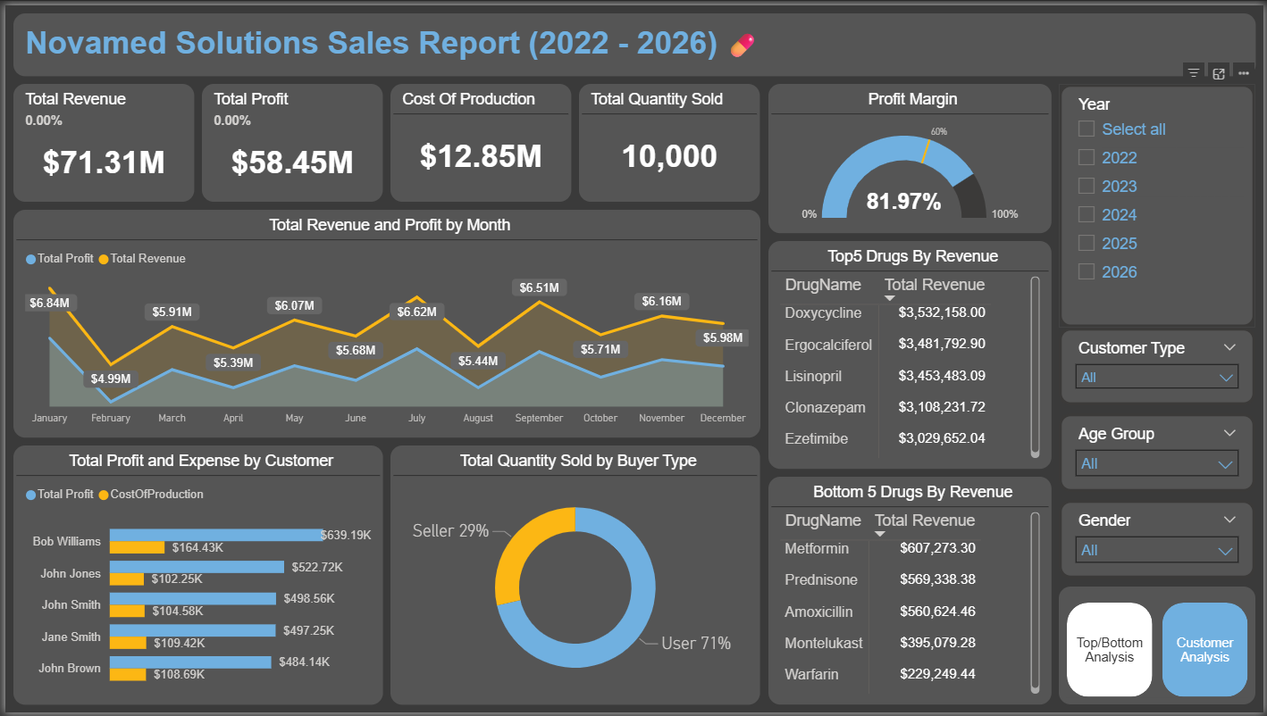
Top/Bottom Analysis

Slide 10
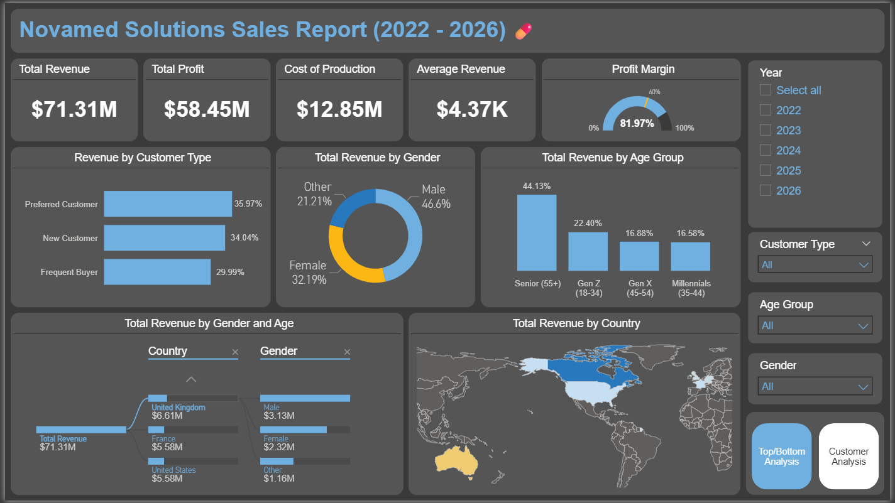
Customer Analysis

Slide 11
Methodology
The SWOT framework (Strengths, Weaknesses, Opportunities, and Threats) has been utilized to evaluate the sales performance of NovaMed Solutions. By integrating SWOT analysis with sales metrics and Power BI dashboards, we identify trends, highlight areas for improvement, and anticipate potential challenges that may impact operations.
This structured approach provides strategic insights beyond mere data, supporting informed decision-making to enhance business strategies and optimize overall performance.

Slide 12
SWOT Breakdown
Strengths: Products such as Doxycycline and Lisnopril, which have the highest profit margins or largest sales volumes, serve as core revenue drivers and contribute significantly to the company's profitability.
Weaknesses: Underperforming products, such as Amoxicillin and Fluticasone, with low revenue or profit margins, reduce efficiency and highlight areas that need reassessment.
Opportunities: Untapped markets and customer segments present potential for revenue growth at relatively low costs. For example, expansion into Australia and targeted campaigns for Generation X frequent buyers could be beneficial.
Threats: External risks include rising costs of raw materials (COGS), declining selling prices, and a significant decrease in annual revenue, which plummeted from $39.26 million in 2023 to $914,000 in 2025. These factors may exert pressure on profit margins and overall competitiveness.

Slide 13
Insights Deep Dive Dimensions
Month-over-month comparison
Top 5 & Bottom 5 Drugs
Customer Performance
Customer Demographics
customer type

Slide 14
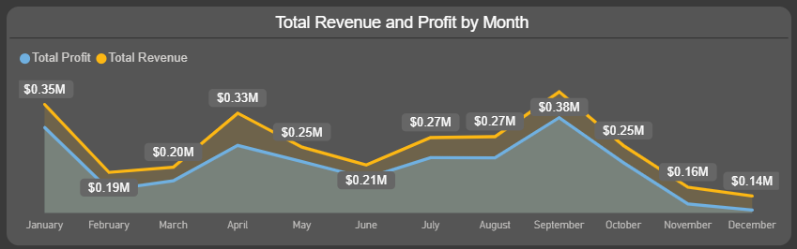
Month-over-month comparison 2022
ghfghf

Slide 15
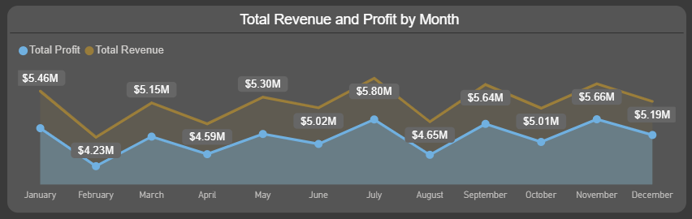
Month-over-month comparison 2023
ghfghf

Slide 16
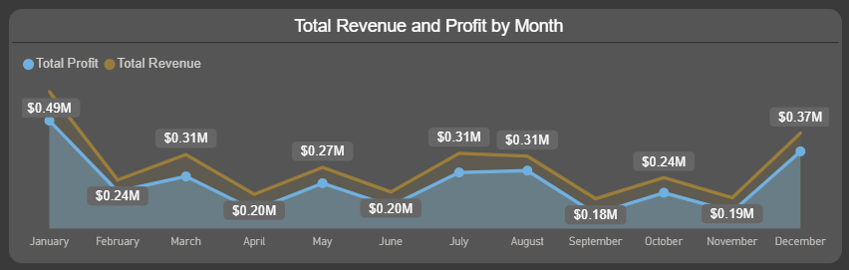
Month-over-month comparison 2024
ghfghf

Slide 17
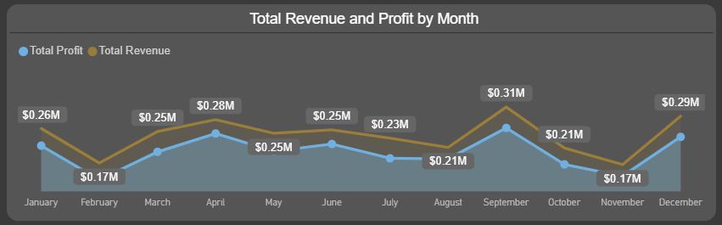
Month-over-month comparison 2025
ghfghf

Slide 18
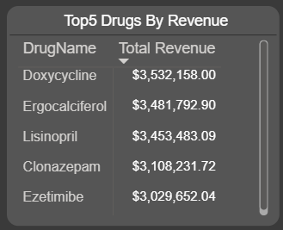
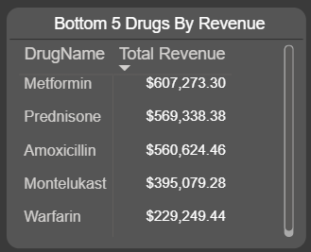
Top 5 & Bottom 5 Drugs
ghfghf

Slide 19
Customer Performance

Slide 20
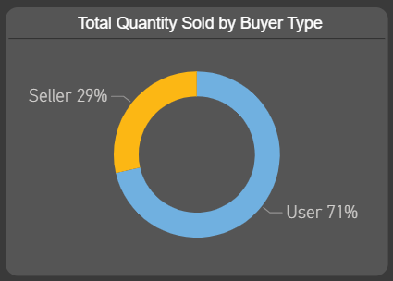
Customer Performance -
ghfghf

Slide 21
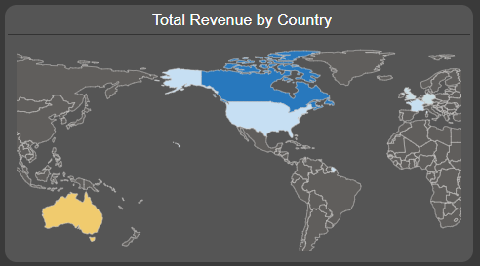
Customer Performance -
ghfghf

Slide 22
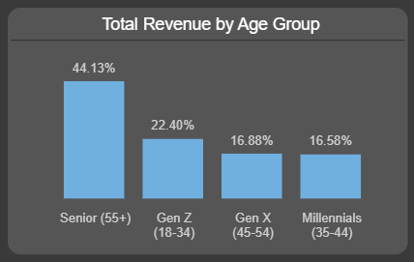
Customer Performance -
ghfghf

Slide 23
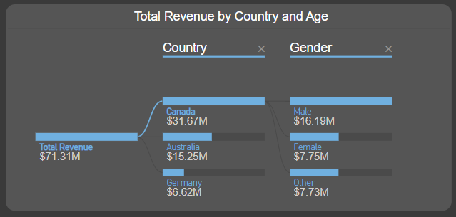
Customer Performance -
ghfghf

Slide 24
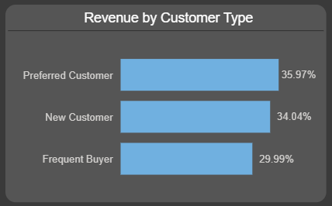
Customer Performance -
ghfghf

Slide 25
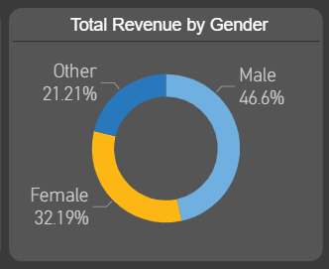
Customer Performance -
ghfghf

Slide 26
Recommendations
1. Revenue & Profit Optimisation
📉 February underperformance → Introduce seasonal promotions or discount campaigns to stabilise sales.
💊 Underperforming drugs (Amoxicillin, Fluticasone, Warfarin, Hydrochlorothiazide, Montelukast) → Bundle with top performers (Doxycycline, Lisnopril) or offer targeted discounts.
📦 Inventory control → Monitor turnover of low-demand drugs to minimise overstocking and reduce holding costs.

Slide 27
Recommendations
2. Top Drug Strategy
🚀 Doxycycline and Lisnopril → Secure long-term supplier agreements to ensure steady availability.
📈 Marketing focus → Invest in campaigns to strengthen dominance of top-selling drugs.
🧪 Portfolio diversification → Explore new drug categories aligned with top performer trends.

Slide 28
Recommendations
3. Customer Relationship Management
🥇 Loyalty programs → Reward top customers (Alice Smith, Bob Williams) with exclusive discounts.
📉 Customer re-engagement → Target underperforming customers (Carol Smith) with personalized offers.
👥 Segmentation strategy → Tailor campaigns by customer type and age group (e.g., incentives for Gen X frequent buyers).

Slide 29
Recommendations
4. Geographical Expansion
🌍 Canada (44% revenue) → Strengthen presence by focusing on preferred senior customers.
🇦🇺 Australia (21.5% revenue) → Expand campaigns targeting frequent senior female buyers.
🌐 Europe (UK, Germany, France) → Explore opportunities in regions with smaller but growing revenue streams.
5. Operational Efficiency

Slide 30
Recommendations
5. Operational Efficiency
🏭 Inventory forecasting → Leverage Power BI predictive models to align stock with seasonal demand.
🔄 KPI dashboards → Deploy real-time Power BI Service dashboards to track revenue, margins, and stock levels.
🕒 Automated alerts → Set notifications for low inventory of high-demand products.

Slide 31
Recommendations
6. Future Growth Opportunities
🔮 Predictive analytics → Forecast sales performance by drug and region.
📱 Customer engagement tools → Develop mobile app or email campaigns informed by demographic insights.
🛒 E-commerce personalization → Recommend products based on purchase history, following best practices from leading retail platforms.

Slide 32
Assumptions
The exceptionally high sales in 2023 are likely due to a strategic partnership or collaboration with another supplier, boosting overall revenue.
The CustomerID corresponding to the Buyer Type in the Fact table had conflicting relationships. It is assumed that the Buyer Type (User or Seller) represents how the customer acquired the medicine, either directly from NovaMed as a user or via a third-party retailer. This assumption is necessary because the Fact table violates the 3rd standard form due to a transitive dependency.If the data were fully normalised, Buyer Type would belong to the Customer table.Therefore, basing results on Buyer Type may slightly misrepresent customer behaviour. It is treated as a pseudo key to indicate the acquisition method rather than a definitive attribute of the customer.
The duplicate salesID had unique entries in other columns, it was assumed that this error was a data entry error and an index SaleID column was created to be a unique ID for the fact table.

Slide 33
Caveats
Data Quality Limitations – Some records may contain errors, duplicates, or missing values, which could slightly affect the accuracy of revenue, profit, or customer analyses.
Buyer Type Interpretation – Since Buyer Type in the Fact table may not fully reflect customer behavior due to normalization issues, insights based on this field should be interpreted with caution.
External Factors Not Considered – Market dynamics, supply chain disruptions, competitor actions, or regulatory changes were not captured in the dataset but could impact actual sales and profitability trends.

